Slide 1

Water Efficiency Incentive

Slide 2
Business Customer Water Efficiency Incentive
How it works
From 1st April 2019 United Utilities will offer an incentive to retailers to support business customers to make water efficiency interventions on their sites.
Incentive payments will be calculated based on the amount of water saved as a direct result of a water efficiency intervention
  Measured by comparing at least three months of consumption data before and after the water efficiency intervention is made. The appropriate time for comparison will be by agreement.
  We will calculate the one off payment based on the number of litres per day saved multiplied by the incentive payment, up to a maximum of £3,000 for a single application.
  Only certain types of intervention are eligible for the incentive
We will require evidence of the interventions made and water savings achieved directly as a result of these interventions
The maximum number of incentive payments made by us per year will be limited
Each SPID will be eligible for the incentive a maximum of once in a two year period
We reserve the right to carry out audits at your customer’s premises in order to verify any savings achieved
Where water efficiencies are not maintained over a two year period, we reserve the right to recover the water efficiency incentive payment from you.
Any disputes arising in relation to these incentive schemes will be resolved in accordance with the Non-Trading Disputes provision within the market codes.

Slide 3
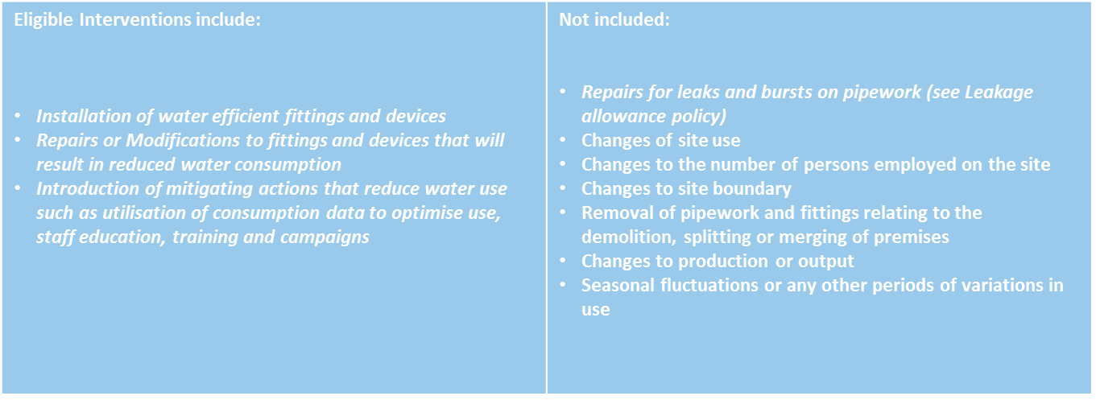
Eligible Water Efficiency Interventions

Slide 4
Application & Claim
The application process will be two stage and include a pre-intervention application and a post intervention claim
Pre-intervention application
The application will detail the intended interventions, expected intervention date, projected water savings with evidence of how the projections are calculated if available
United Utilities will validate the application for eligibility and complete the following checks:
      The application is materially complete and that all required information and evidence has been supplied
      The application is for savings from water efficiency interventions only
      Retailer, customer, SPID, meter and supply point details
      Historical fluctuations in use to determine the correct usage comparison period
      Previous allowance claims against the affected SPIDs
Upon a complete application passing eligibility and validation United Utilities will confirm to the retailer that the site has been accepted onto the Water Efficiency incentive payment scheme with a 6 month validity.

Slide 5
Application & Claim
Post-incentive claim
The retailer will provide
    Confirmation of the date on which the interventions have been made
    A ‘Start Interventions Read’ +- 2 business days of the actual date of interventions
    From actual date of intervention, an evidenced visual monthly reading +-2 business days for the following 3 calendar months
UUW will accept as evidence a meter reading that has been obtained by a meter reading provider, a customer or a third party providing photographic evidence is produced that clearly shows
    The meter and serial No
    The reading
    Location
Upon a validation by UUW that the post incentive claim contains correct meter readings with the relevant supporting evidence, confirmation of the incentive amount will be sent to the retailer and the relevant payment will be processed.

