Slide 1
October 2023
Gavin Shirtcliffe
Developer Day
Why?
Unlocking Value from Smart Meters

Slide 2
There is more demand for water and less predictable supply
The future climate of North West England The University of Manchester, June 2022
More people
There has been a 30% increase in England’s population from 1961 to 2021
Longer dryer summers
By 2050
Summers will be 18% drier
Winters will be 13% wetter
Shorter wetter winters
Why?
Each using more water
Personal water use in the home has increased by over 60% since the 1960s

Slide 3
UU is committed to water sustainability in the North West
We need to use our water more sustainably and more responsibly. This means using less and losing less. UU is committed to further reducing leakage and encouraging water efficiency to help ensure future water resilience.
Leakage
Leakage
50% (~224 Ml/d) reduction by 2050
(compared to 2017 levels ~449 Ml/d)
PCC
Per Capita Consumption
110 litres/person/day by 2050
Business Usage
Business Usage reduction
8.3 % reduction by 2030
15% reduction by 2050
Notes:
Add business usage – reduction in c. 8%

Slide 4
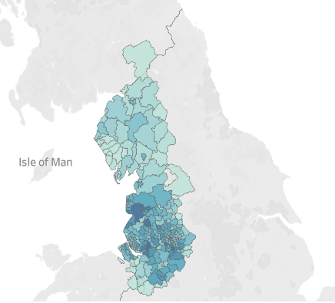
Current Metering Challenges in United Utilities
We operate 1.64m meters, 89% of which are domestic. These meters are concentrated in the south of our region
We have one of the lowest water company HH meter penetrations (49%) and have modest AMP7 growth (+6% meter penetration)
Domestic meters
1.46m
Commercial meters
0.18m
Our meters are either read visually
or
Utilise AMR technology with the ability to collect reads when driving or walking by

Slide 5
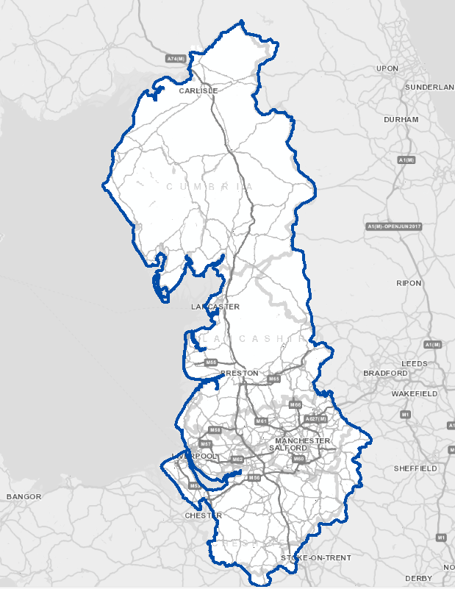
Smart meters will be installed in mass – The Smart meter data will support the reduction of water use and identify losses
New meter installs
Customer Requested
Enhanced Metering
Roll out Advanced metering Infrastructure
How?
Renewals
Fix on Fail
Pro-active
New Connection
Efficient homes

Slide 7
What does this mean to you?

Slide 8
Review of Meter location policy for Smart Technology Rollout
Different Metering Technology
Incentives to build more efficient homes
Review of Meter location policy for Smart Technology Rollout
Ease of Installation
Ability to procure directly

Slide 9
Meter Location policy review?
Above ground meter external to the dwelling?
Above ground level - Communal areas in apartments
Benefits to consider
Leakage – continuous supply pipe from main
Reduced Property damage during build stage
HBF and Water UK best practice guidelines
Replacement – reduced customer impact
Smart Technology connectivity
Challenges
Product choice - sole active supplier
Importance of correct installation - Training
Supply pipe through wall structure - disruptive to alter
Different wall structures/rendering
Formal Industry Consultation
(Please Respond!)

